Slide 1

NODE JS
Aruna S
Department of
Computer Science and Engineering

Slide 2

NODE JS
Event Loop and Event Emitter
S. Aruna
Department of Computer Science and Engineering

Slide 3
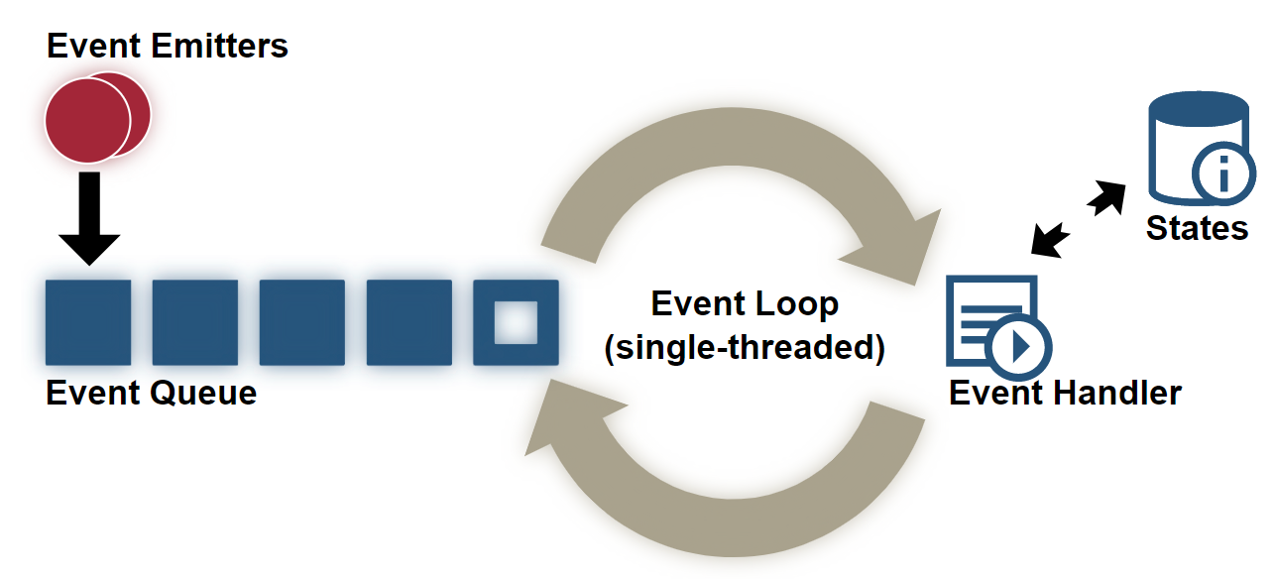
NODE JS
Events Architecture flow

Slide 4
NODE JS
Events
Node.js is a single-threaded application, but it can support concurrency via the concept of event and callbacks.
Every API of Node.js is asynchronous and being single-threaded, they use async function calls to maintain concurrency.
Node uses observer pattern. Node thread keeps an event loop and whenever a task gets completed, it fires the corresponding event which signals the event-listener function to execute.

Slide 5
NODE JS
Event Driven Programming
Node.js uses events heavily and it is also one of the reasons why Node.js is pretty fast compared to other similar technologies.
As soon as Node starts its server, it simply initiates its variables, declares functions and then simply waits for the event to occur.
In an event-driven application, there is generally a main loop that listens for events, and then triggers a callback function when one of those events is detected.

Slide 6
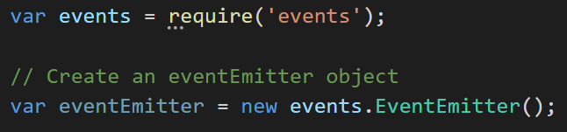
NODE JS
EventEmitter Class
The functions that listen to events act as Observers.
Whenever an event gets fired, its listener function starts executing. Node.js has multiple in-built events available through events module and EventEmitter class which are used to bind events and event-listeners

Slide 7
NODE JS
EventEmitter Class
EventEmitter provides multiple properties like on and emit. on property is used to bind a function with the event and emit is used to fire an event.
Methods:
addListener(event, listener)
on(event, listener)
once(event, listener)
removeListener(event, listener)
removeAllListeners([event])
setMaxListeners(n)
listeners(event)
emit(event, [arg1], [arg2], [...])

Slide 8
NODE JS
EventEmitter Class
Class Methods:
listenerCount(emitter, event)
Events:
newListener
event − String: the event name
listener − Function: the event handler function
This event is emitted any time a listener is added. When this event is triggered, the listener may not yet have been added to the array of listeners for the event.
removeListener
This event is emitted any time someone removes a listener. When this event is triggered, the listener may not yet have been removed from the array of listeners for the event.

Slide 9
NODE JS
Child_Process Module
Node.js runs in a single-thread mode, but it uses an event-driven paradigm to handle concurrency. It also facilitates creation of child processes to leverage parallel processing on multi-core CPU based systems.
Child processes always have three streams child.stdin, child.stdout, and child.stderr which may be shared with the stdio streams of the parent process.
Node provides child_process module which has the following three major ways to create a child process.
exec − child_process.exec method runs a command in a shell/console and buffers the output.
spawn − child_process.spawn launches a new process with a given command.
fork − The child_process.fork method is a special case of the spawn() to create child processes.

Slide 10
THANK YOU
Aruna S
Department of
Computer Science and Engineering
arunas@pes.edu

